Slide 1


Cloud Computing With AWS
Presentation On Internship Program
Internship Performed At
Under AWS Academy
Presented BY- RAHUL SHARMA
Roll No.-171190101023
CSE 4th Year
Date-17/08/2020

Slide 2

Overview
Why We Learn Cloud Computing With AWS
Introduction To Cloud Computing
Service Model of Cloud Computing
Amazon Web Services
Amazon Web Services Overview
AWS Global Infrastructures
Companies Using AWS
Features
Pricing/Costs
Various Projects

Slide 3

Why we Learn Cloud Computing with AWS
High Demand
With every business going online and using cloud, the demand for this skill is very high and continue to grow.
To Improve our Earing Potential
By Forbes, Professional with an AWS CSAC have a potential annual salary of $125971.
Secured Jobs
This is because most companies find it difficult to find IT professionals with this skills they need.
It is the Future
Online Streaming, E-commerce, machine learning, IOT and More, it is powering the Future

Slide 4
Introduction to Cloud Computing
Most of the people still thinks Cloud is only a Storage, but Cloud can actually used for lots of different tasks and application that we want to do Local Server, Local Machine and On all premises data centers.
Basically, Cloud Computing is On-Demand Delivery of computing Power, Database, Storage, Application and other IT Resources.
It can be used for the interest with Pay-As-You-Go pricing.
Deployment Model
Public Cloud
Hybrid Cloud
On-premises Cloud

Slide 5
Service Models
IAAS
Infrastructure as a Service, Cloud-based services, pay-as-you-go for services such as Storage Networking and Virtualization
PAAS
Platform as a Service, Hardware and Software tools available over the internet
SAAS
Software as a Service, Software that is available via a third- party over the internet

Slide 6














Amazon Web Services
AWS provides cloud computing platforms and APIs on a pay-as-you-go basis.
In 2020, they offer 212 Services
Categories like Compute, Storage, Networking, Database, Analytics Application, Services, Deployment And IOT.
Subscriber pay for OS/Software/Networking/Availability and service options.
Computing
Database
Storage
Analytics
Application
Services
Deployment
Access to AWS Services
AWS management Console
Command Line Interfaces
Software Development Kits

Slide 7










AWS Services Overview
EC2 Server
Consider a web application which is to hosted.
As the number of users increases, your servers become slow
As a feature of cloud computing, the moment your servers becomes slow a new server is launched to take the extra burden, and return to normal state
EC2 Server
RDS
EC2 Server
Load
Balancer
EC2 Server
USER
Internet
Route 5.3
VPC

Slide 8
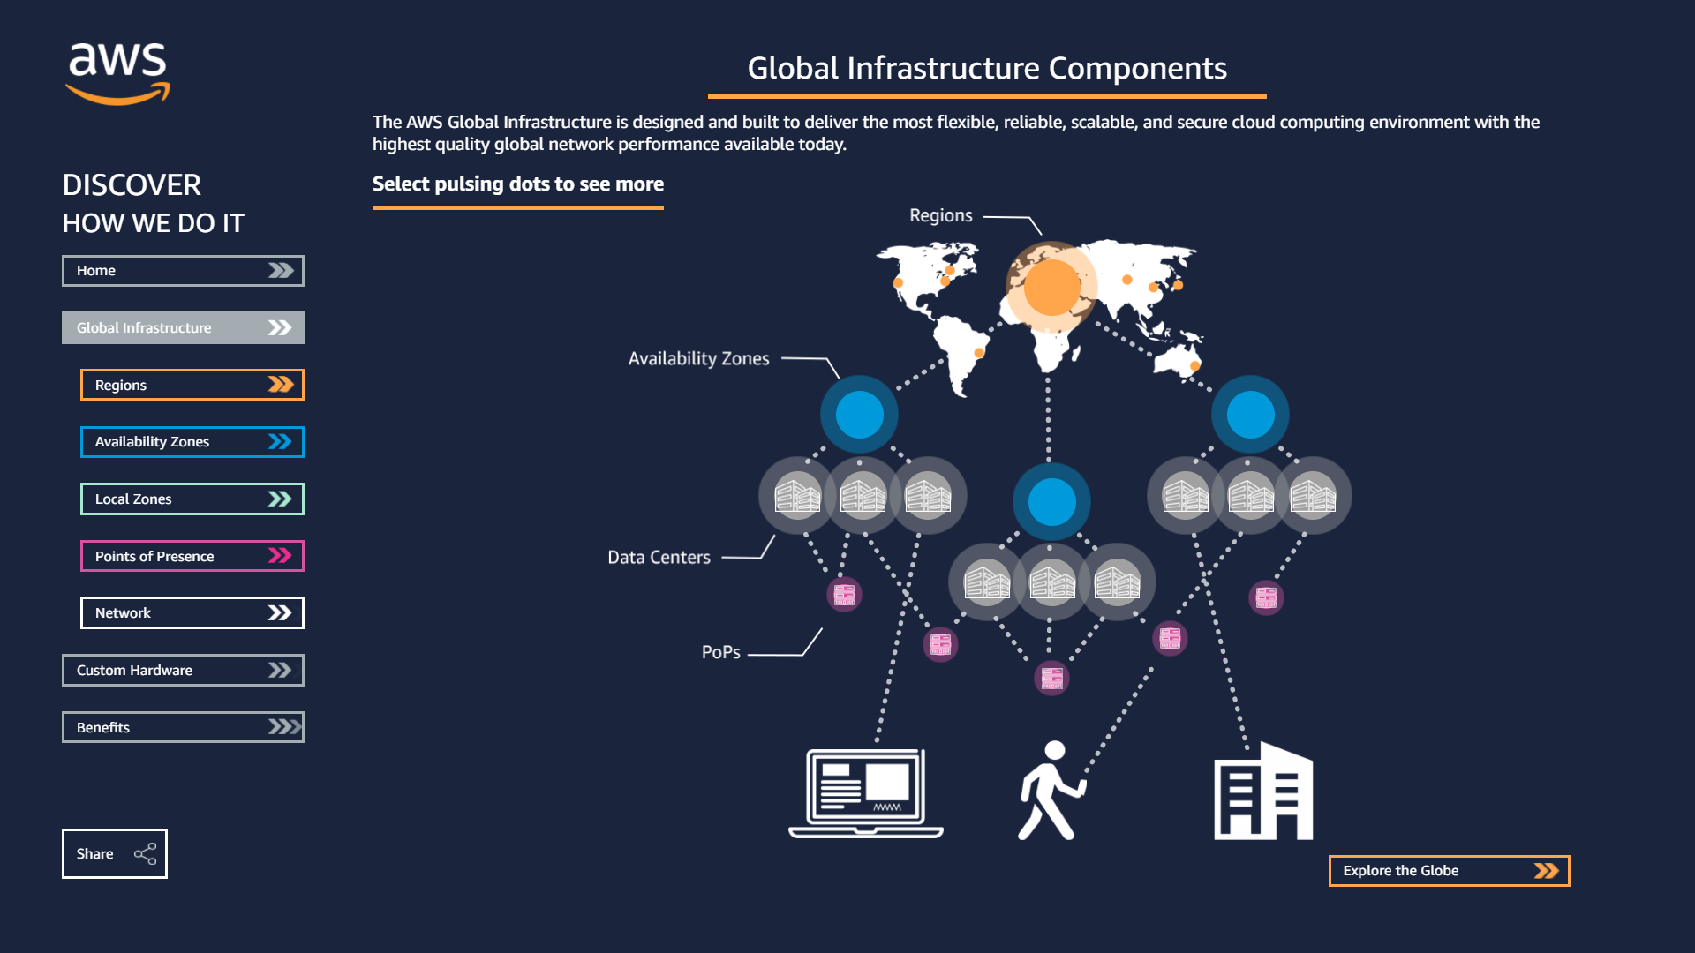

Global Infrastructure Component

Slide 9
AWS Global Infrastructures
AWS Data Centers
Availability zones
Data centers are where actual data resides
Physical servers in the form of racks
Redundant power, networking and Connectivity
Typically 50000 to 80000 servers in one Data Center
Cluster of Data Centers is called an Availability Zone
Isolated partition of the AWS Infrastructure
69 Availability zones Worldwide
We can choose our own AZ

Slide 10
AWS Global Infrastructures
Regions
Point of presence
Geographical Area
22 region Worldwide
Consist of at least 2 AZs for fault isolation
AWS recommends copying data across AZ for resiliency
Communication between regions goes over te public internet
Edge location are used to stores cached content for faster delivery
Services like CloudFront use edge location to store data across the world
Data can be written to edge locations directly
Consists of 176 edges location and 11 Regional Edge Caches

Slide 11






Companies Using AWS
Amazon
Kellogg's
Airbnb
Adobe
General Electric
NETFLIX

Slide 12
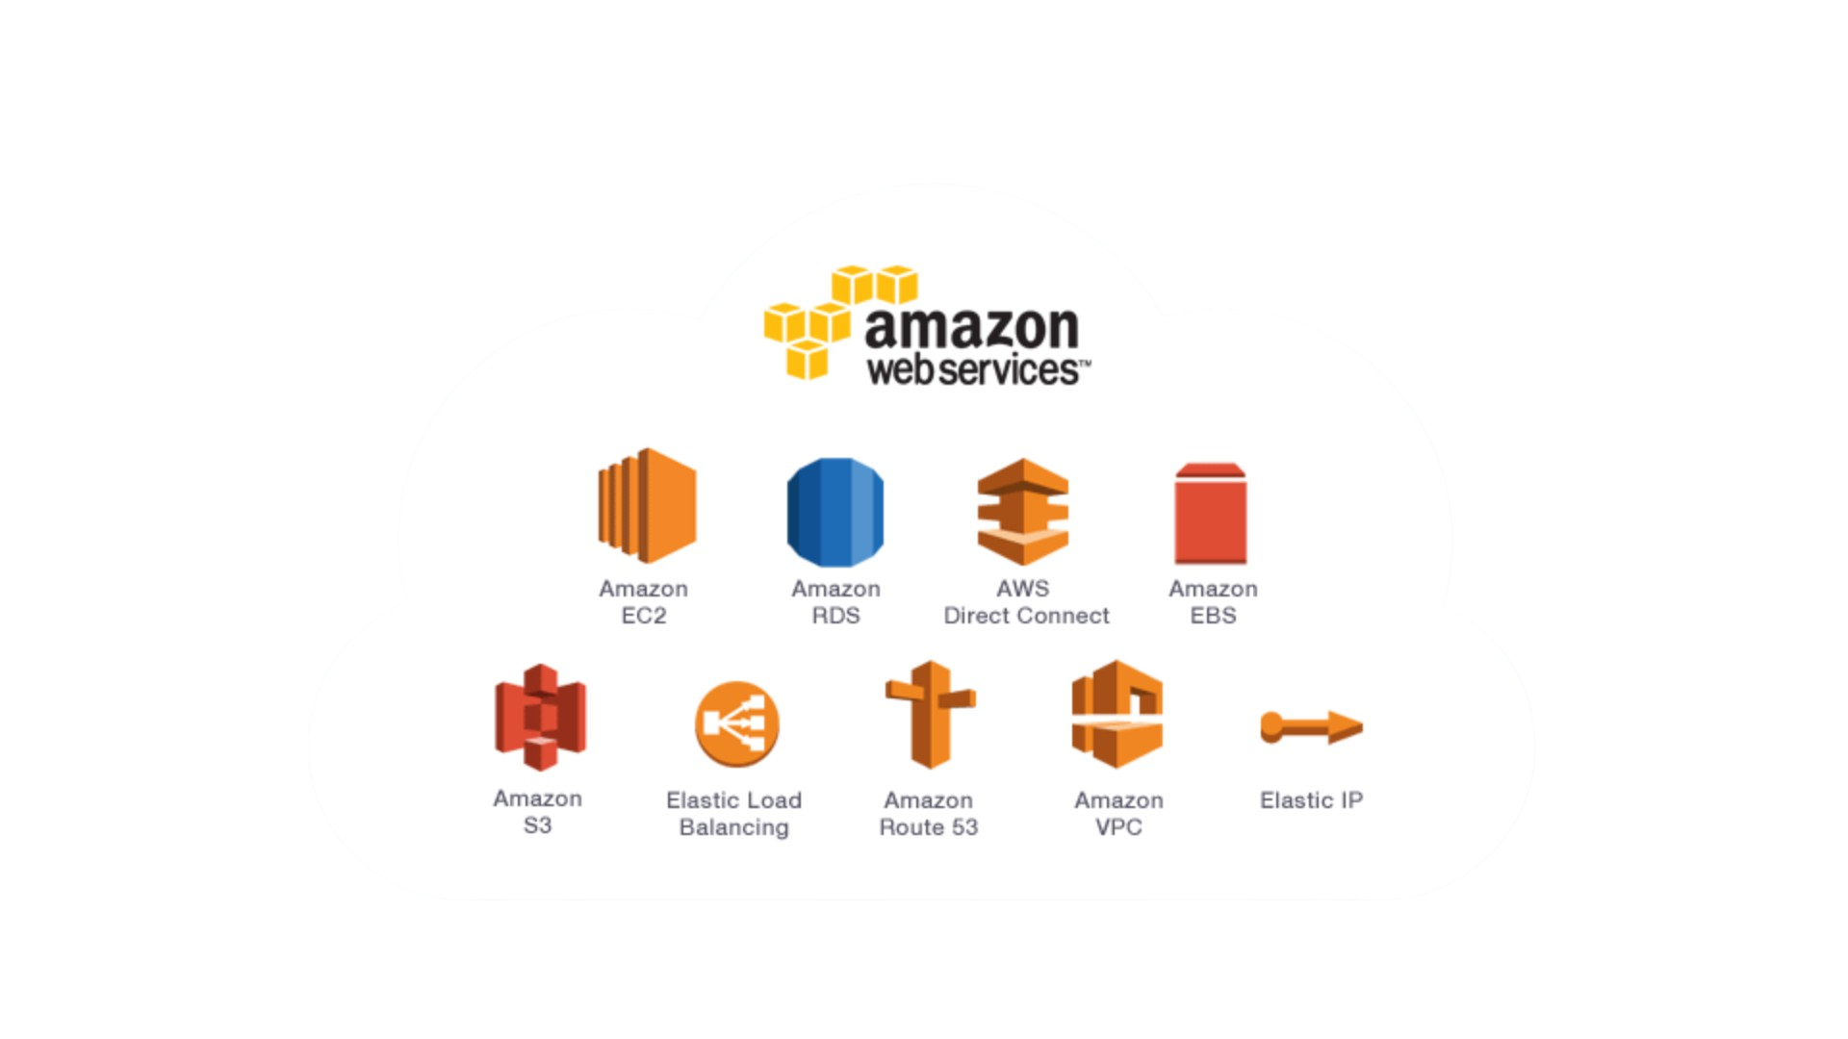
Features
High Availability
Minimized Downtime
No human intervention
Operational performance
Fault Tolerance
Ability to withstand failure
Built in redundancy of services
Scalability
Ability to accommodate growth by adding capacity automatically
Elasticity
Ability to shrink capacity when not required by terminating capacity

Slide 13

AWS Pricing/Cost
Per hour billing
Region Specific Pricing
Saving up to 90% on reserved instances
Get incredibly low prices using spot pricing

Slide 14
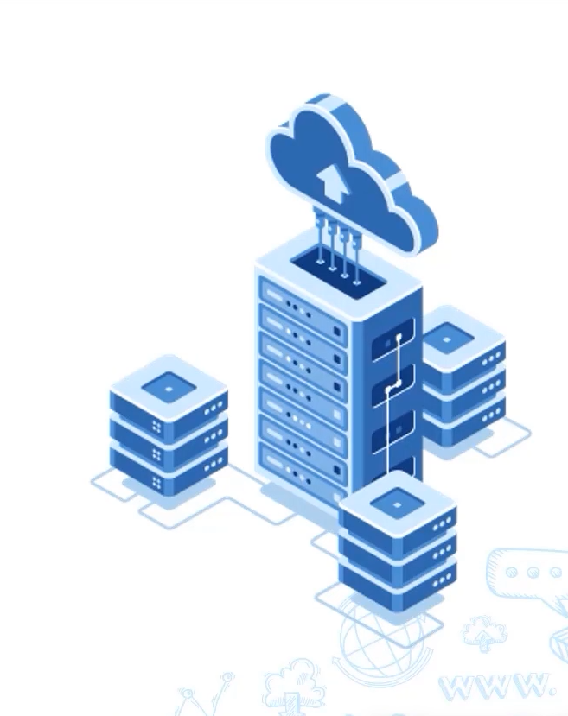
Worked On These Various Projects
A Static website in S3(Simple Storage Service)
Set up a static Website in S3, use CloudFront distribution, show page load times, and set up restriction
Set up a highly available website in the network
Create a Virtual Private Cloud (VPC), Create public subnets in the VPC, a load balancer, and more
Set up a highly available relational database service (RDS)
Create an RDS that’s highly available, modify the database setting, and more.

Slide 15

Thank You

